Slide 1
Single Class Detection-based Deep Learning Approach for Identification of Road Safety Attributes
Thihagoda Gamage Pubudu Sanjeewani
PhD Candidate (Post CoC), ARC Linkage Project Scholarship
Principal Supervisor: Prof. B. Verma
This paper has been accepted (minor revision) for Neural Computing and Applications Journal.
Web of Science Listed Journal
Impact Factor: 4.774 (2019), Ranked Q1 Journal in SCIMAGO

Slide 2
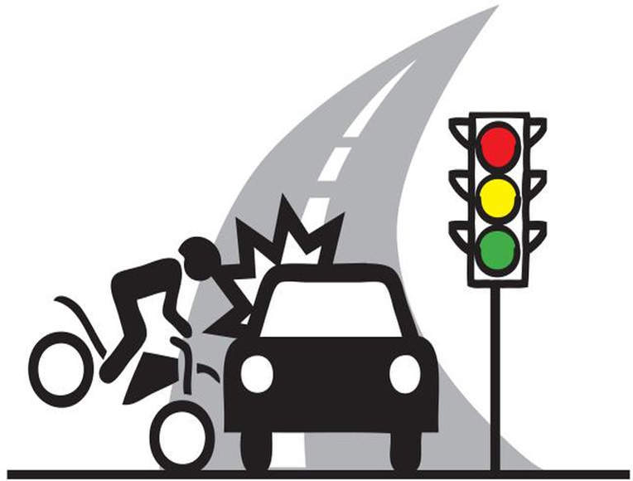




Introduction
Many challenges in automated and manual road safety system in detecting all road safety attributes accurately
Very little research using video data to assess road safety
Deep learning technology has higher object detection accuracy
They can extract deep features inside images autonomously.
Existing deep learning models fail in real world applications

Slide 3
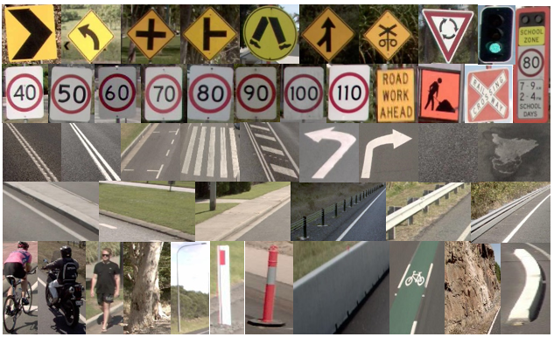
Objective
Develop a deep learning-based segmentation and classification technique for automatically identifying road safety attributes and,
Evaluate the proposed technique on roadside video data.
Fig. 1: Road Safety Attributes

Slide 4




Problem Statement
Requirement of a large dataset for training.
Class imbalance problem.
Requirement of re-training using all training samples when a new attribute is introduced.
Overfitting problem.
4
Source: Google Images

Slide 5
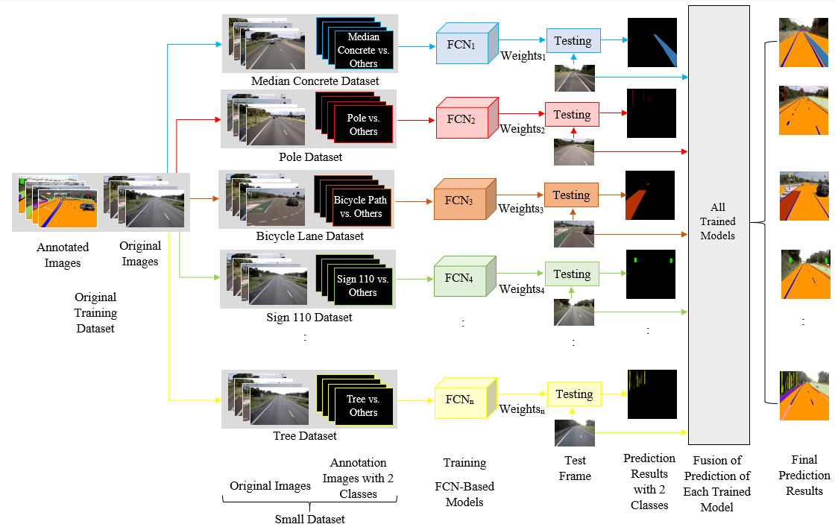
Proposed Technique
Fig. 2: Proposed Technique

Slide 6
Training and Testing Algorithms
Training Algorithm
Step 1: Create n datasets (n is the number of attributes) from original dataset.
Each dataset contains only two classes.
Step 2: Feed each set of training data (original images and the annotated class images) to each FCN.
Step 3: Set FCN parameters such as filters, layers, training algorithm, etc.
Step 4: Start training each FCN separately through convolution layer, pooling layer, etc.
Step 5: Compute the error and learn/optimize model parameters using back propagation.
Step 6: Combine class 1 output of each FCN to create an output frame.
Step 7: Save the trained weights and other parameters of all FCN models.
Step 1: Load the trained weights and other FCN parameters.
Step 2: Feed the test frame to all FCN models.
Step 3: Calculate the output using FCN’s convolutional layer, pooling layer, etc.
Step 4: Create one frame from each FCN output by using class 1 output.
Step 5: Combine all output frames to create the final predicted frame.
Step 6: Convert the predicted frame/image to color image for visual comparison and save the results.
Testing Algorithm

Slide 7
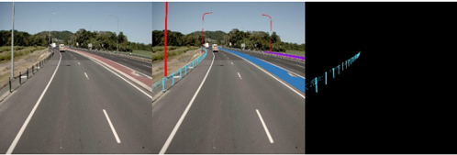
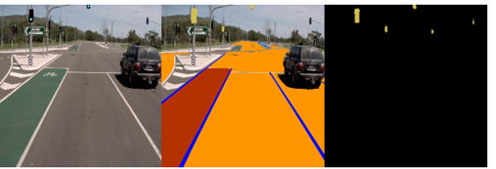
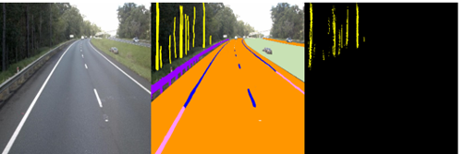
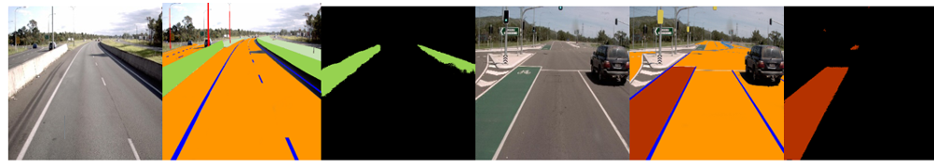
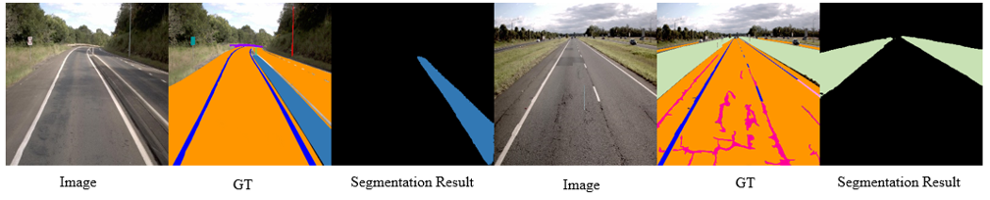
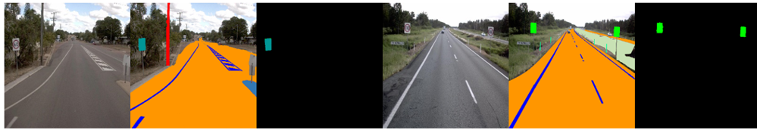
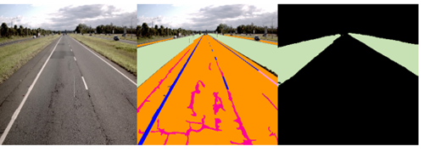
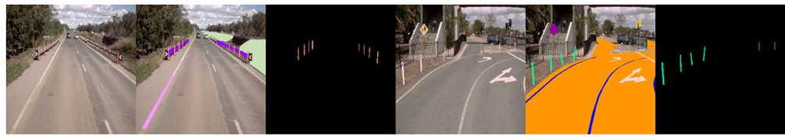
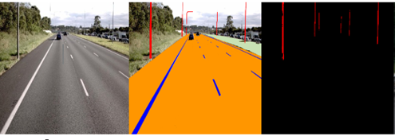
Results
Wire Rope Barrier
Signal Light
Tree
Concrete Barrier
Bicycle Path
Median Concrete
Sign 60
Sign 110
Median Grass
Flexipost
Guidepost
Pole

Slide 8
Test Accuracy and Misclassifications on Real-World Test Data
Attribute | Test Accuracy (%) |  | Misclassifications
 | Object Wise | Pixel Wise
Signal light | 93.31 | 74.00 | 0
Merge lane sign | 100.00 | 88.00 | 0
Railway sign1 | 100.00 | 88.00 | 0
Sign 10 | 100.00 | 52.97 | 0
Curvature sign | 100.00 | 72.00 | 1
Roadworks sign2 | 100.00 | 81.00 | 1
Railway stop signage | 100.00 | 97.00 | 2
Bicycle path | 93.00 | 95.00 | 2
CAM | 100.00 | 97.00 | 3
Sign 90 | 100.00 | 91.00 | 5
Rigid structure | 60.00 | 22.00 | 6
School zone sign | 100.00 | 95.00 | 6
Sign 70 | 81.00 | 85.00 | 6
Sign 80 | 100.00 | 91.00 | 6
Deep drainage ditch | 92.86 | 84.00 | 6
Segregated bicycle path with barrier | 87.60 | 93.00 | 6
Pedestrian crossing sign | 100.00 | 97.00 | 10
Test Data: 283 Frames from Queensland Roads

Slide 9
Comparison

Slide 10





Conclusion
Proposed technique achieved good accuracy and can accurately detect road safety attributes.
Better results compared to the multi-class based deep learning technique.
0 misclassifications for many attributes.
The accuracy for many attributes depends on the number of iterations used in proposed method.
Advantages
Many benefits such as higher accuracy, quick training, use of small dataset and incorporation of new attributes without retraining of the whole system.
10
Source: Google Images

Slide 11


Source: Google Images

Slide 12

Q & A
Source: Google Images

